Slide 1
Introduction to Cryptography

Slide 2
Field of Cryptology

Slide 3
Cryptology
Cryptography
Symmetric Ciphers
Asymmetric Ciphers
Cryptanalysis
Protocols
Cryptography or cryptology is the practice and study of techniques for secure communication in the presence of third parties called adversaries.

Slide 4
Symmetric Cryptography Example
secret-key

Slide 5
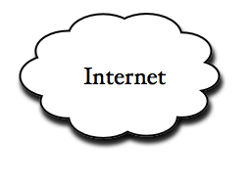



Problem of Internet: Unsecure
Unsecure
Bad guy

Slide 6
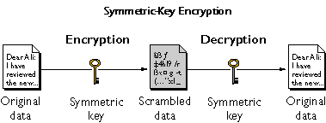

https://www.ibm.com/support/knowledgecenter/en/SSB23S_1.1.0.14/gtps7/s7symm.html

Slide 7
x=plaintext
K
y=ciphertext
K
key space = Set of all keys {K1, K2, ...,Kn}
https://www.ibm.com/support/knowledgecenter/en/SSB23S_1.1.0.14/gtps7/s7symm.html

Slide 8
Math Formula for symmetric cryptography
Encryption equation y = e (x, k)
Decryption equation x = d (y, k)
The key transmission
Must via a secure channel between Alice and Bob.
Methods
Manually installing the key for the Wi-Fi Protected Access (WPA) protocol
Post office

Slide 9
The idea of secure communication
The system is only secure if an attacker does not learn the key K
The problem of secure communication is reduced to secure transmission the key K

Slide 10
Cryptanalysis

Slide 11
Motivation: Why do we need Cryptanalysis
There is no mathematical proof of security for any practical cipher
The only way to have assurance that a cipher is secure is to try to break it (and fail) !

Slide 12
Implementation Attack: Try to extract key through reverese engineering
Social Engineering: E.g., trick a user into giving up her password
Cryptanalysis
Classical Cryptanalysis
Mathematical Analysis
Brute-Force Attack
implementation Attack
Social Engineering

Slide 13
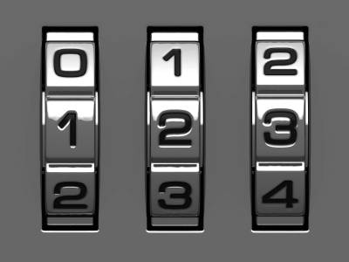
Brute-Force Attack
Repetitive successive attempts of trying various keys (password) combinations to break into any systems
How many keys to we need ?
10*10*10=1000

Slide 14
Key space and key length
Key length (size) in bits
Key space
10*10*10=1000= 2 ¹⁰
x=0 or 1
=
x | x | x | x | x | x | x | x | x | x

Slide 15
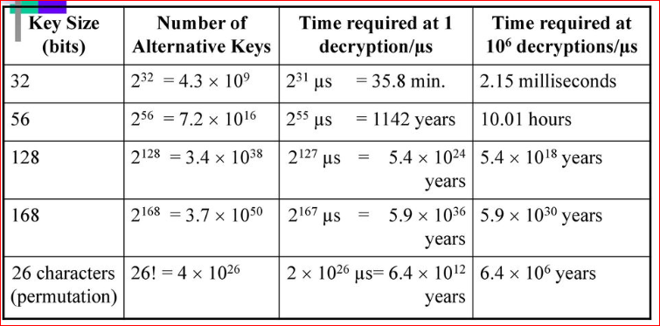
Key strength
https://slideplayer.com/slide/12031562/69/images/53/Average+time+required+for+exhaustive+key+search.jpg

Slide 16
Lab: Generate password

Slide 17
Question 1?
We want to guess the code (key) for a lock.
How many keys do we have to try?
How to generate a wordlist (contains all possible keys) for password cracking. Let's assume that we know the lock has passwords with 4 digits.

Slide 18
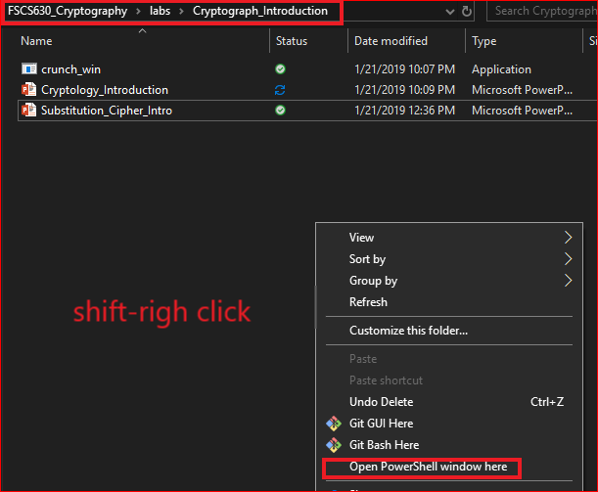
Use Windows command

Slide 19
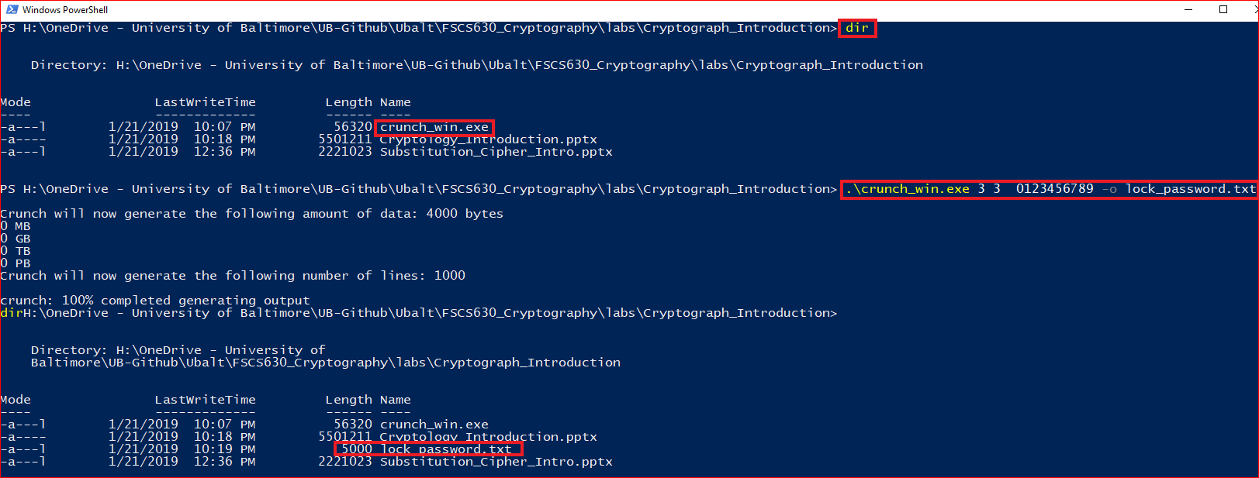
Generate password

Slide 20
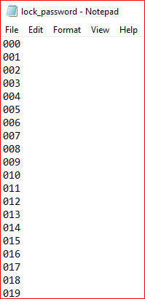
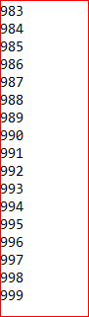
List generated password

Slide 21
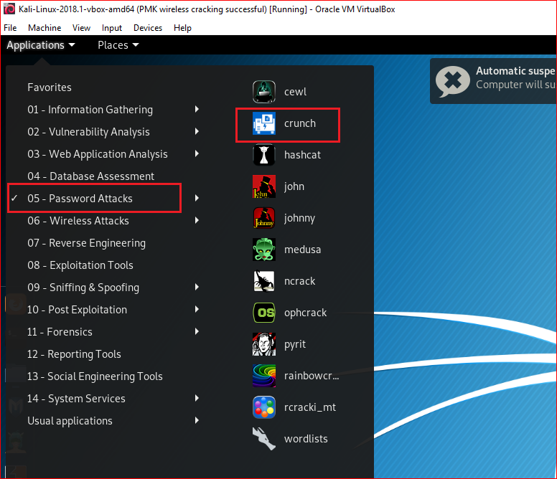
Use Linux

Slide 22
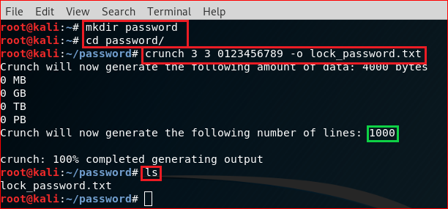
crunch <min-len> <max-len> [<characterset>] [-o outputfile]
Min-len = The minimum password length.
Max-len = The maximum password length.
characterset = The character set to be used in generating the passwords.
-o outputfile = This is the file you want your wordlist written to.

Slide 23
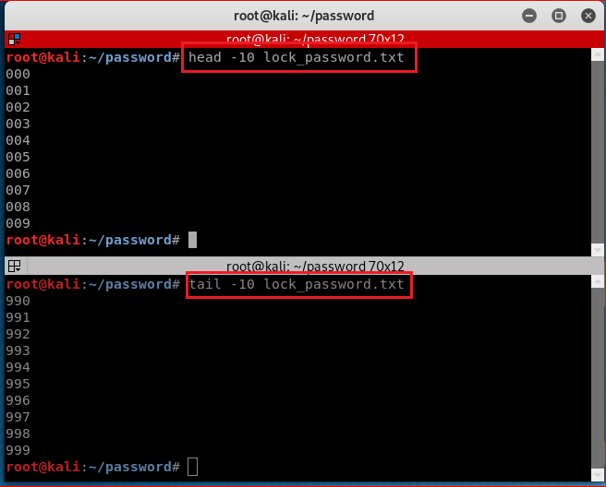

Slide 24
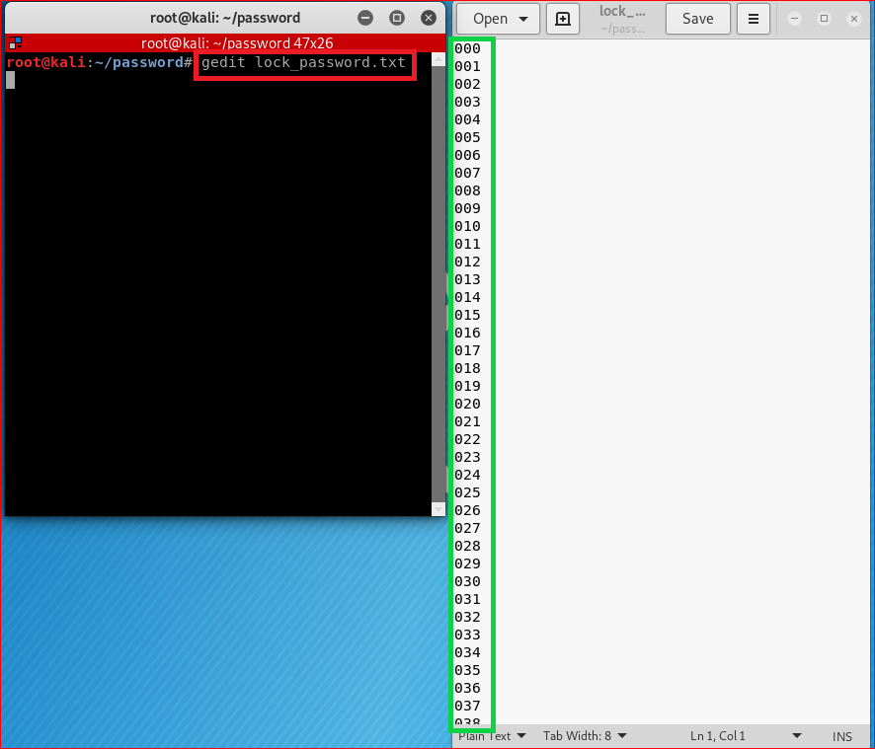

Slide 25
Question 2
Let's assume that we know one has an email password is 4 characters.
characters: 26 low case letters a-z
How many possible keys?
Key space
26*26*26*26=456,976

Slide 26
Question 2
We can generate all the possibilities in crunch by typing crunch 4 4 -o wordlist4_8.txt

Slide 27
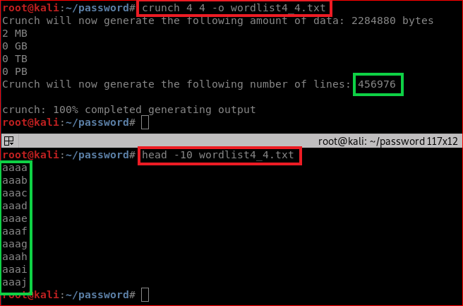

Slide 28
Question 3
If we knew that the target's birthday was July 12 and they likely used that date at the end of a eight-character password.
We could generate all the possibilities of eight-character passwords that end with 0712
You name the file as birthdaywordlist.txt
abcd0712

Slide 29
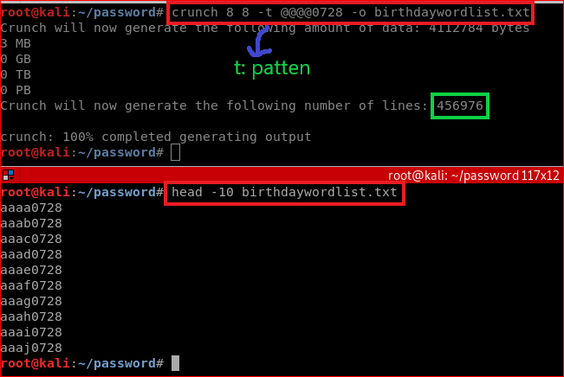
@ will insert lower case characters
* will insert upper case characters
% will insert numbers
^ will insert symbols

Slide 30
Question 4
If we knew that your neighbor’s wifi password has the following patterns
Less than and equal to 10 characters
Start with his first name with lower case: frank
End with his birthday
You task is to generate all the possibilities passwords
You can name the file as wifiwordlist.txt, e.g., frank0712
How many passwords?
Notes:
9 9 -t frank%%%% -o wifiwordlist.txt
10 10 -t frank@%%%% -o wifiwordlist.txt

Slide 31
References
https://github.com/shadwork/Windows-Crunch/releases

